Slide 1
Chapter 4
Software

Slide 2
Chapter Outline
Assembler, compiler, and linker are tools
for generating object programs
Loader transfers programs into memory and handles execution initiation/termination
Debugger identifies programming errors
I/O and other tasks can be programmed
in multiple languages
Operating system manages everything

Slide 3
The Assembly Process
Source program created using text editor
Written to file on disk for later processing
Assembler translates source file to object code
Recognizes mnemonics for OP codes
Interprets addressing modes for operands
Recognizes directives that define constants and allocate space in memory for data
Labels and names placed in symbol table

Slide 4
Two-Pass Assembler
Consider forward branch to label in program
Offset cannot be found without target address
Let assembler make two passes over program
1st pass: generate all machine instructions, and enter labels/addresses into symbol table
Some instructions incomplete but sizes known
2nd pass: calculate unknown branch offsets using address information in symbol table

Slide 5
Loading/Executing Object Programs
Loader invoked when user types command
or clicks on icon in graphical user interface
User input identifies object file on disk
Object file has information on starting location in memory and length of program
Loader transfers object program from disk to memory and branches to starting address
At program termination, loader recovers space in memory and awaits next command

Slide 6
Separate Processing of Object Files
Can partition one program into multiple files
Can also use subroutines defined by others
Let assembler process each file separately, making list of unknown external names
Object file augmented with list of names and list of instructions with external references
Programmer must also export names from an object file that could be used with other files

Slide 7
The Linker
Combines object files into object program
Constructs map of full program in memory using length information in each object file
Map determines addresses of all names
External names matched with exported names
Instructions referring to external names are finalized with addresses determined by map
Unmatched names are reported as errors

Slide 8
Libraries
Subroutines that are useful in one program are often useful in other programs
Separate file assembly and linking enables
reuse of source files with these subroutines
Alternatively, generate object files once and use archiver to collect them into a library file
Library includes name information to aid in resolving references from calling program

Slide 9
The Compiler
Assembly-language programming requires knowledge of machine-specific details
Programming in a high-level language (like C) reduces need for machine-specific knowledge
Program in high-level language must be translated into assembly language for machine
The compiler performs this translation
The assembler processes compiler output file

Slide 10
The Compiler
Just as in assembly language, use multiple files to partition a program in high-level language
Must declare external subroutines & variables
Enables checking of data types across all files
Assembler invoked for each output file, then
linker combines object files (with any libraries)
Compiler automates various tedious tasks, such as managing stack frames for subroutines

Slide 11
Compiler Optimizations
Assembly-language program from compiler may not be efficient in size or execution time
An optimizing compiler applies techniques to enhance performance or reduce code size
Much execution time is spent in loops
Optimize performance by using registers to hold value of loop index and other variables
Use Load/Store instructions before/after loop

Slide 12
Programs Using Multiple Languages
Once assembler generates an object file,
original source language is less relevant
Linker combines object files & library routines for source programs written in any language
Machine-specific calling conventions define register usage and stack frames
Routines written in assembly language can call high-level language routines, and vice-versa

Slide 13
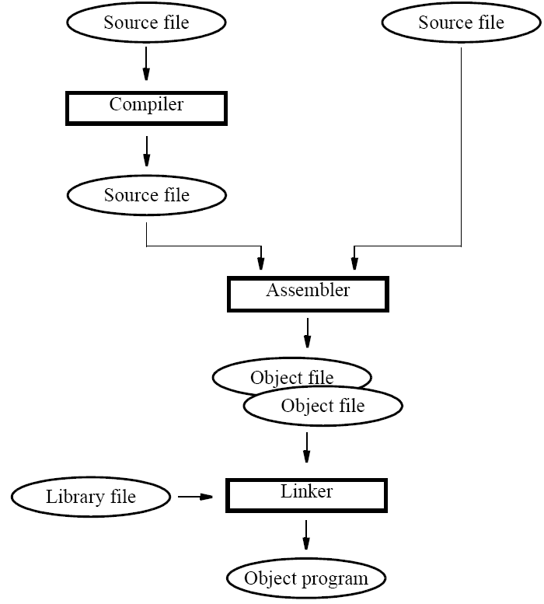

Slide 14
The Debugger
Programming errors, or bugs, can cause an object program to produce incorrect results
The debugger enables the programmer to identify such errors at execution time
Execution can be stopped at points of interest
At such points, debugger accepts commands to display contents of registers or memory
Execution resumed until next point of interest

Slide 15
Trace Mode and Breakpoints
The debugger can use trace mode interrupts
Service routine invoked after each instruction to enable user to inspect registers/memory
Trace mode disabled within debugger, then re-enabled upon return from interrupt
Breakpoints involve placing software-interrupt instruction in program to enter debugger
Old instruction restored to resume execution

Slide 16
Using a High-Level Language for I/O
Use of high-level language preferred due to ease of program development & maintenance
Consider example in assembly-language and C for I/O task to show use of high-level language
Polling of keyboard, sending chars to display
Assembly-language reads/writes I/O registers and uses polling loop to check device status
C program must perform same operations

Slide 17
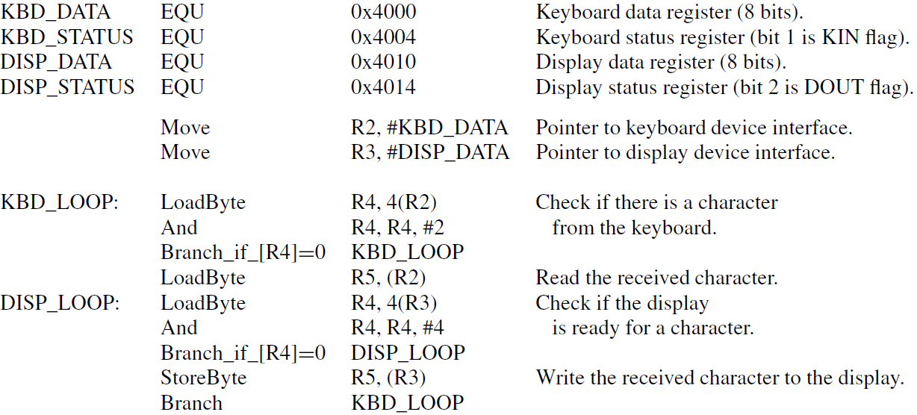

Slide 18
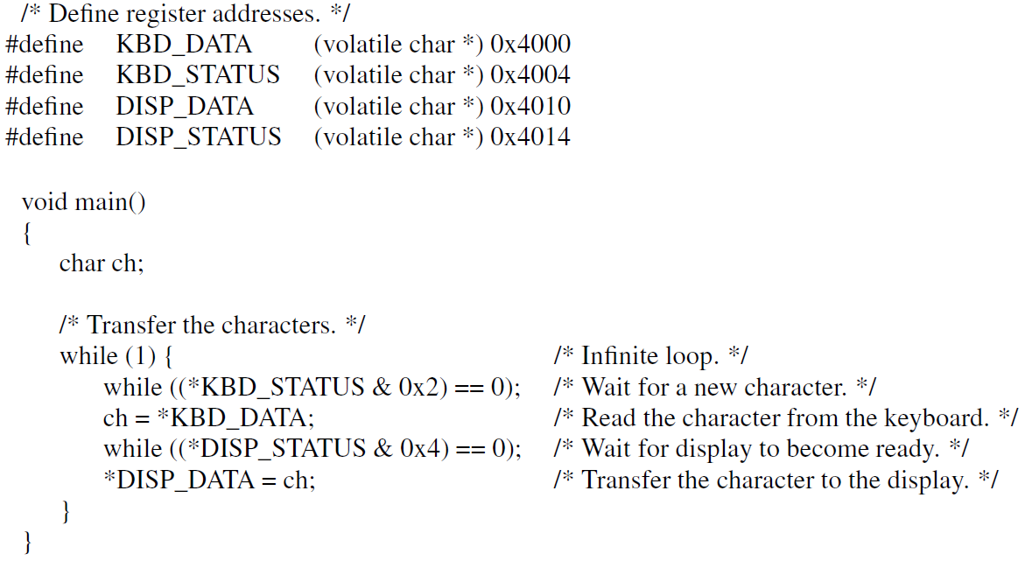

Slide 19
Using a High-Level Language for I/O
#define statements in C are similar to EQU for associating a symbolic name with an address
They also define pointer type for C code
Use of volatile qualifier is important for I/O
Prevents unwanted compiler optimizations that might use register instead of I/O location
Also necessary in presence of cache memory; ensures cache is bypassed when accessing I/O

Slide 20
Interaction: C ↔ Assembly Language
Program may need access to control registers
Example: enabling processor interrupts
Assembly-language instructions used for this, but no equivalent in high-level language like C
Compilers therefore permit inclusion of such instructions within high-level source program
Use similar keyboard/display example, but
now with interrupts from keyboard interface

Slide 21
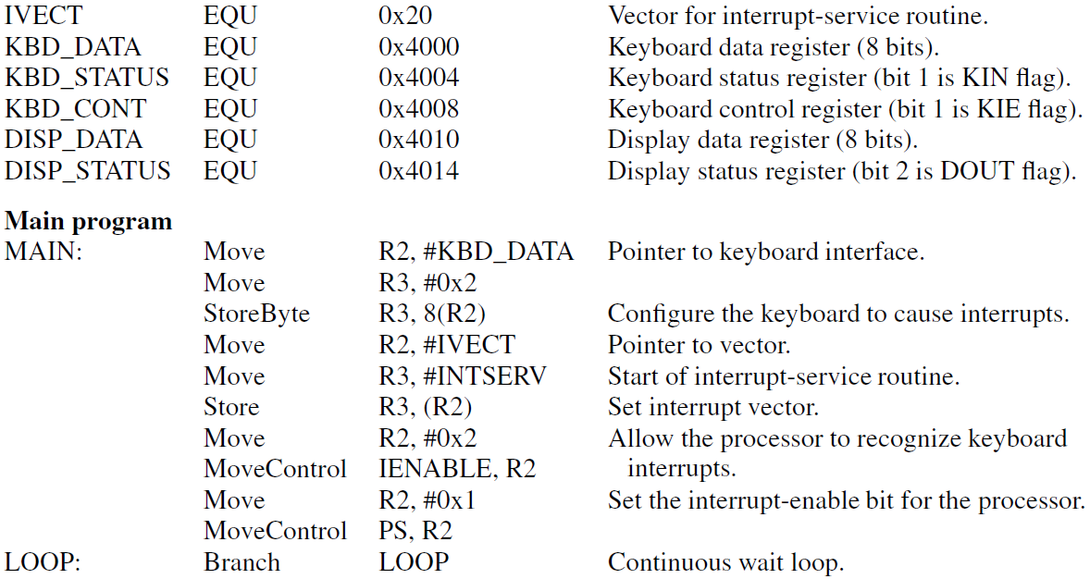

Slide 22
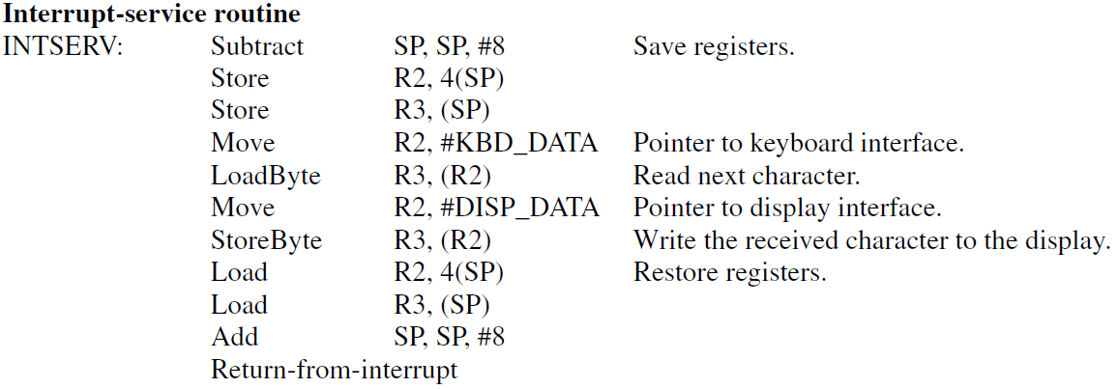

Slide 23
Interaction: C ↔ Assembly Language
Main routine peforms necessary initialization
Accesses keyboard I/O control register to enable interface to assert interrupt request
Writes service routine address to location in memory that holds interrupt vector
Accesses processor control register using special instruction to enable interrupts
Service routine sends each char. to display

Slide 24
Interaction: C ↔ Assembly Language
Processor control register has no address, so
#define technique cannot be used as before
Must use special instruction that compiler does not emit in output assembly language
Use special asm() directive to insert desired assembly-language instructions where needed
Service routine must end with proper return instruction; use special interrupt directive

Slide 25
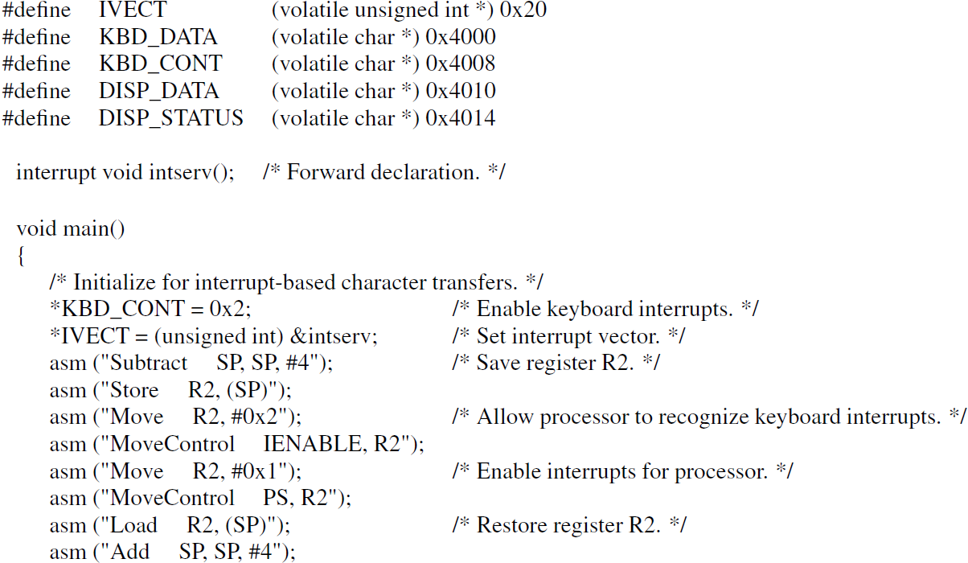

Slide 26
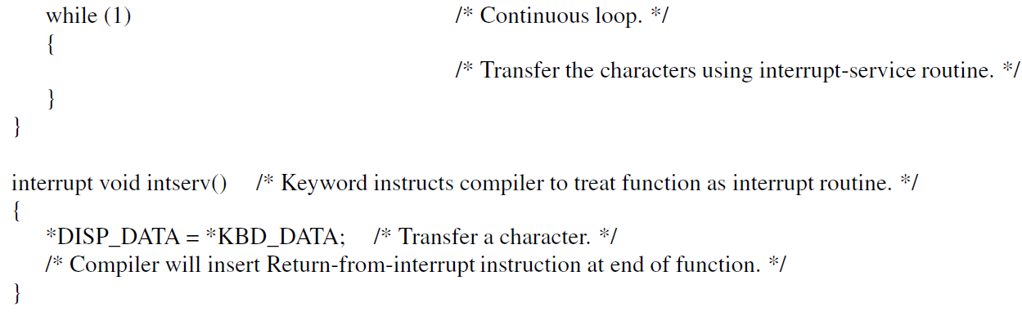

Slide 27
The Operating System
Coordinates all activities in a computer system
Comprises essential memory-resident routines and utility programs stored on magnetic disk
Manages processing, memory, I/O resources
Interprets user commands, allocates storage, transfers information, handles I/O operations
Loader discussed previously is part of OS
Used by OS to execute application programs

Slide 28
The Boot-strapping Process
OS for general-purpose computer is large
All parts, including memory-resident, on disk
Boot-strapping loads memory-resident part, enabling OS to assume control over resources
At power-up, processor fetches instructions initially from permanent memory to read disk
Progressively larger programs transfer OS into memory in preparation for user commands

Slide 29
Managing Execution of Programs
Discuss OS operation with example computer having keyboard, display, disk, and printer
User enters command, loader transfers code and data in object file to memory to execute
To read data file on disk, request made to OS
OS and I/O activity occur while program waits
Program waits again after sending to printer
Timeline diagram illustrates this behavior

Slide 30
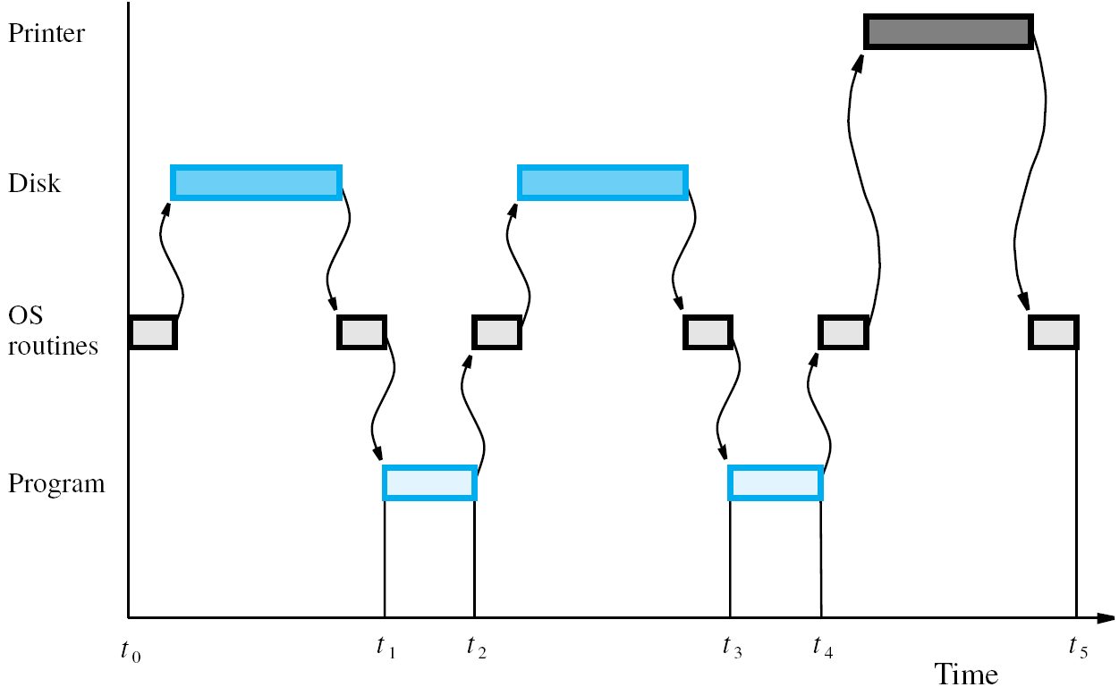

Slide 31
Managing Execution of Programs
Computer resources not being used efficiently when I/O devices and processor are idle
Start execution of other application programs before initial program terminates
Concurrent processing for computation and I/O requests can result whenever possible
OS manages activity for efficient utilization
Called multiprogramming or multitasking

Slide 32
Use of Interrupts in Operating Systems
Interrupts used extensively for I/O operations
Also enable OS to assign execution priorities, switch between programs, coordinate I/O, etc.
Service routines for I/O devices are part of OS
I/O requests made through library routines that raise software interrupt to enter OS
OS initiates I/O activity while program waits
Hardware interrupts signal completion to OS

Slide 33
Example of Multitasking
Multitasking requires various OS capabilities
OS uses hardware timer for time slicing when managing execution of multiple programs
Enables fair allocation of processor usage
OS must also support I/O requests to enable concurrent computation and I/O activity
Consider organization of OS software with initialization, scheduler, I/O routines, drivers

Slide 34
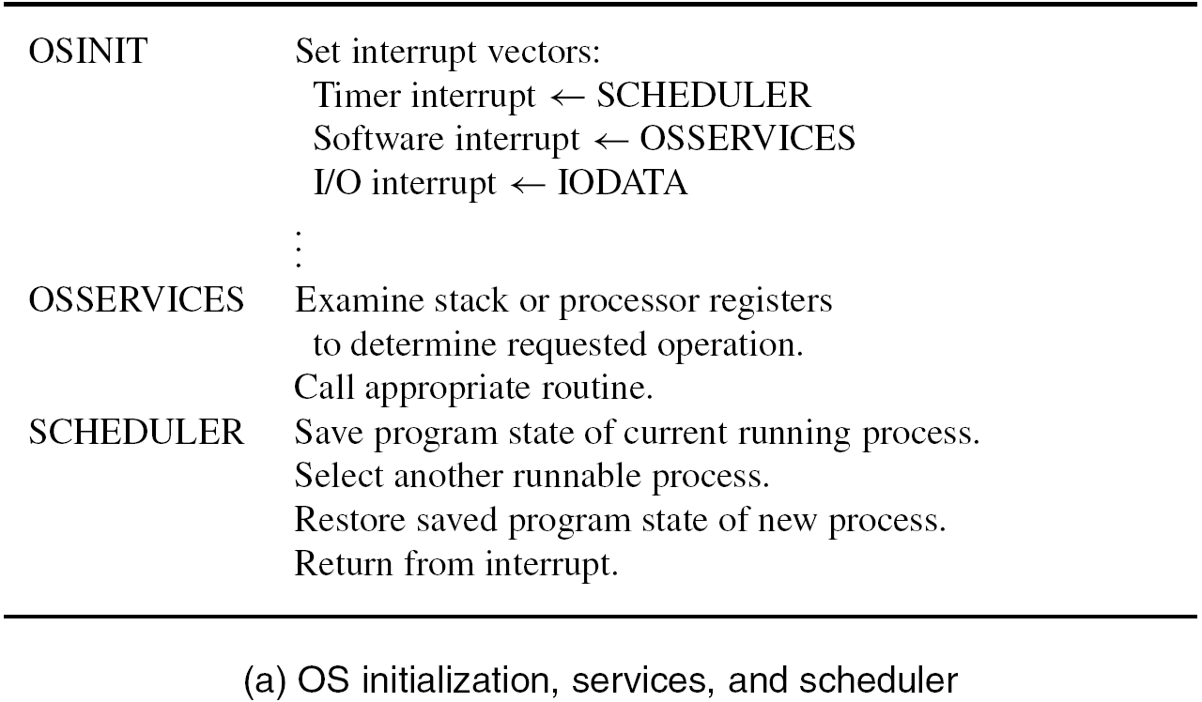

Slide 35
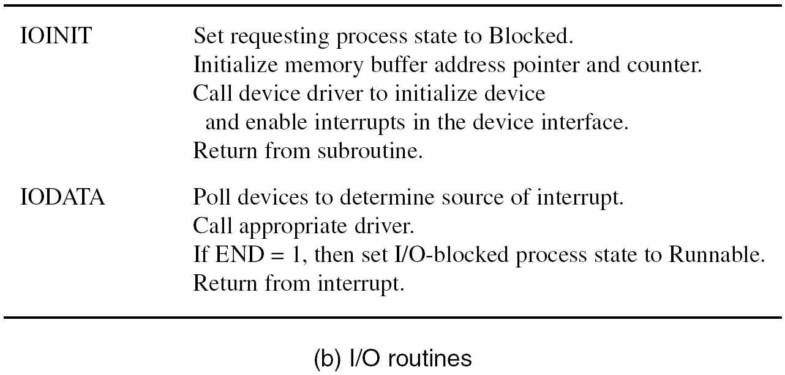

Slide 36
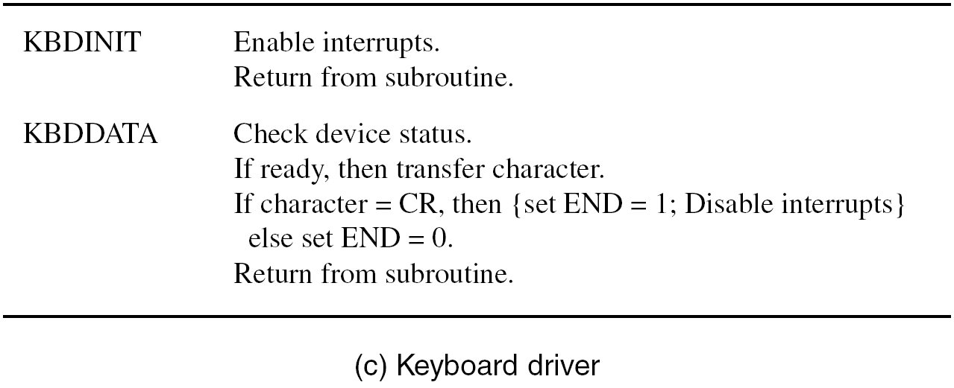

Slide 37
Example of Multitasking
A process is a program with its execution state
Can be Running, Runnable, or Blocked for I/O
Assume application programs A and B initiated
If A is executing when time slice expires,
SCHEDULER is entered and registers are saved
OS then selects B, restores its register values, then uses return-from-interrupt to resume B
This event sequence is called a context switch

Slide 38
Example of Multitasking
Now A calls I/O routine for software interrupt
OS calls IOINIT, then KBDINIT in device driver
Device interrupts are enabled for transfer
SCHEDULER routine in OS then selects B
Keyboard interrupt invokes IODATA routine which polls devices to find interrupt source
A made Runnable, OS lets B resume execution
After later context switch, A executes again

Slide 39
Concluding Remarks
Software makes computers useful & versatile
Utility programs enable creation, execution, and debugging of application software
High-level language and assembly language can be used for the same program
Where necessary, assembly language can be included within high-level source program
OS and multitasking provide more versatility

